Slide 1
Hostel Management System final year project
GUIDED BY SUBMITED BY
Prof. MR.Rajbhan singh Harsh Kumar Mishra (Professor CSE) Pramod Kumar Singh
Prof. MR.Sanjay Gupta Vikaram Pathak
(H.O.D CSE) Dhruv Kumar Kushwaha

Slide 2
Introduction
Hostel Room allocation system is a web application which aims at computerization of current procedure of allocating hostel rooms.
Currently the process involves students filling up the forms and submitting them in respective hostel offices which involves a lot of paperwork, hence less efficient !

Slide 3
Front end of project
"Front-end" typically means the parts of the Software a user interacts with--such as the graphical user interface or command line.

Slide 4
LANGUAGE USED IN Front end
HTML :- Page layout has been designed in HTML.
CSS :- CSS has been used for all the desigining part.
JavaScript :- All the validation task and animations has been developed by JavaScript.

Slide 5
BACK END OF PROJECT
"Back-end" means the parts that do the work, but the user is unaware of or cannot see. Databases, services, etc.

Slide 6
LANGUAGE USED IN BACK END
PHP :- All the business and frontend logic has been implemented in PHP.
MySQL :- MySQL database has been used as database for the project.

Slide 7


Types of Users
Student
Admin

Slide 8
Student

Slide 9
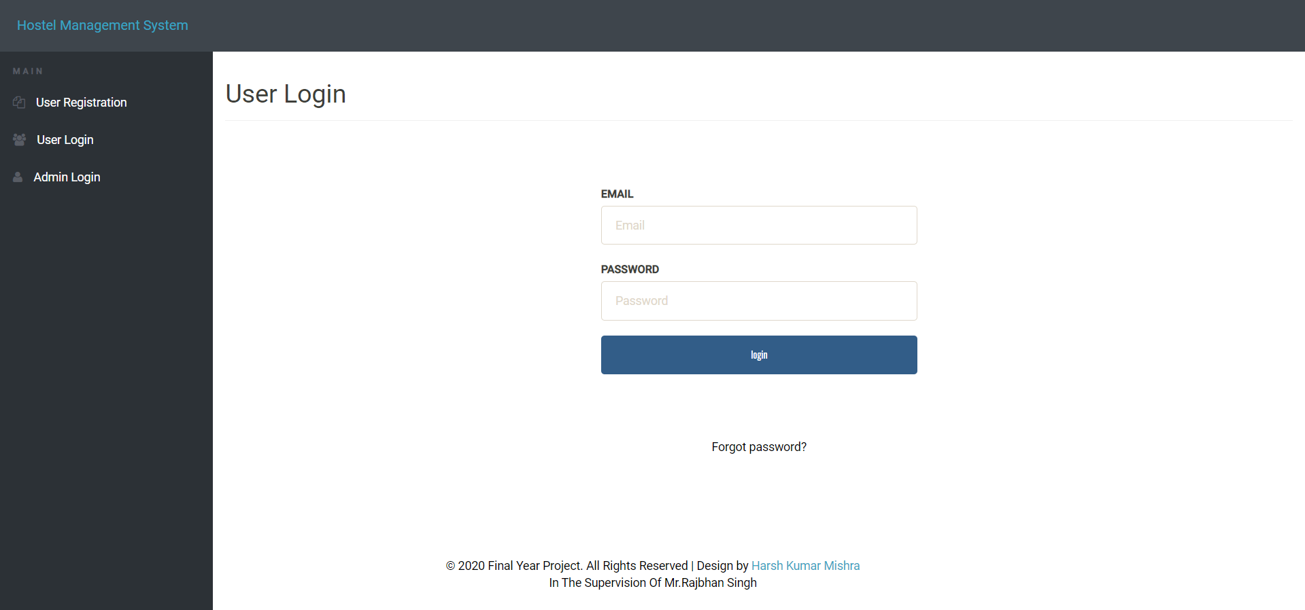
Login Page
If and only if the user exists in DB and password entered is correct, he/she will be able to login, otherwise appropriate error message is displayed.

Slide 10
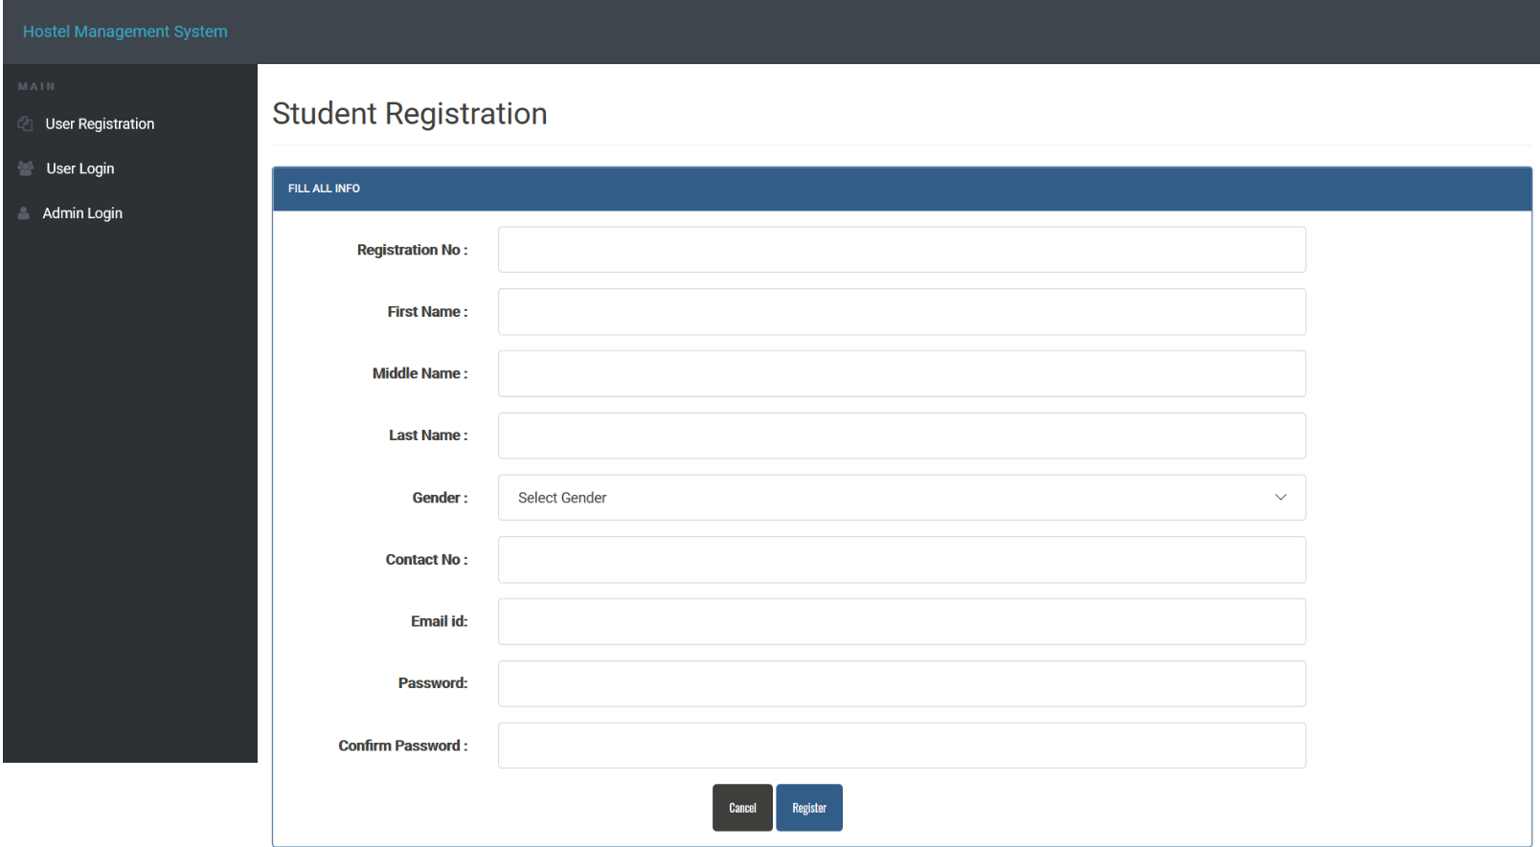
Registration page
Students who are not a part of the portal can register themselves here.
Hostel Manager cannot sign up, he/she can only login
All the necessary error conditions are checked.(like if a user with the entered roll number already exists)

Slide 11
Admin

Slide 12
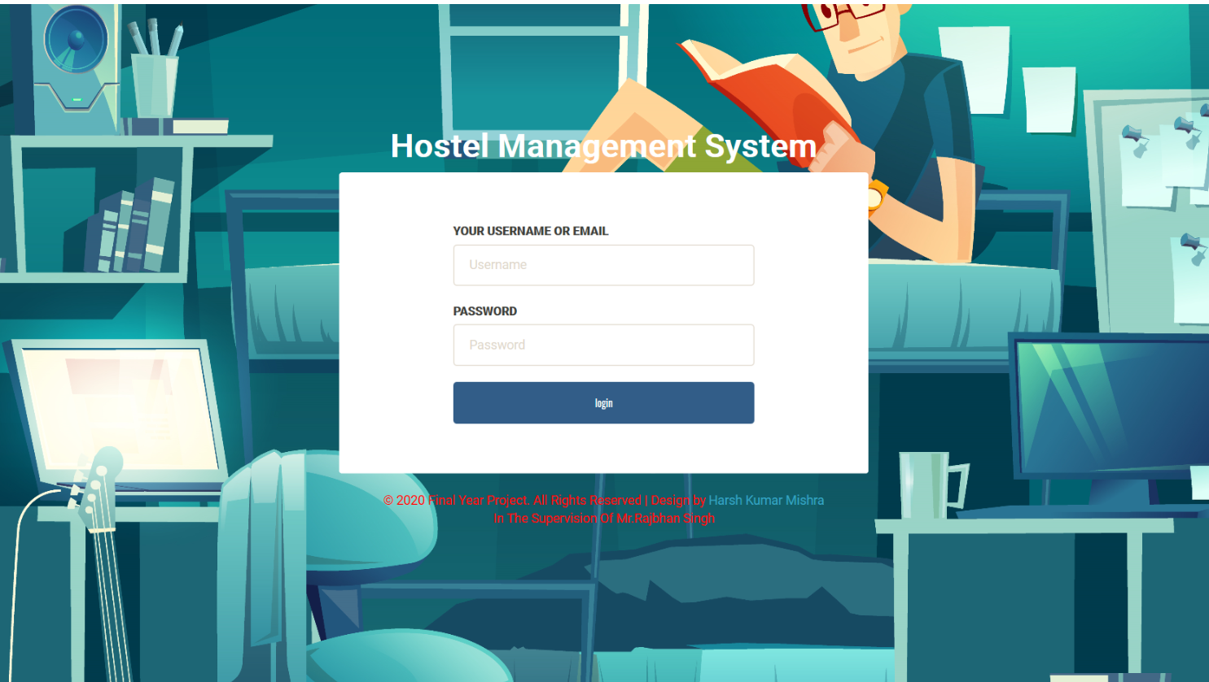
Admin login
If and only if the admin exists in DB and password entered is correct, he/she will be able to login, otherwise appropriate error message is displayed.

Slide 13
Thank You ! desiGned by harsh Kumar mishra

